Slide 1

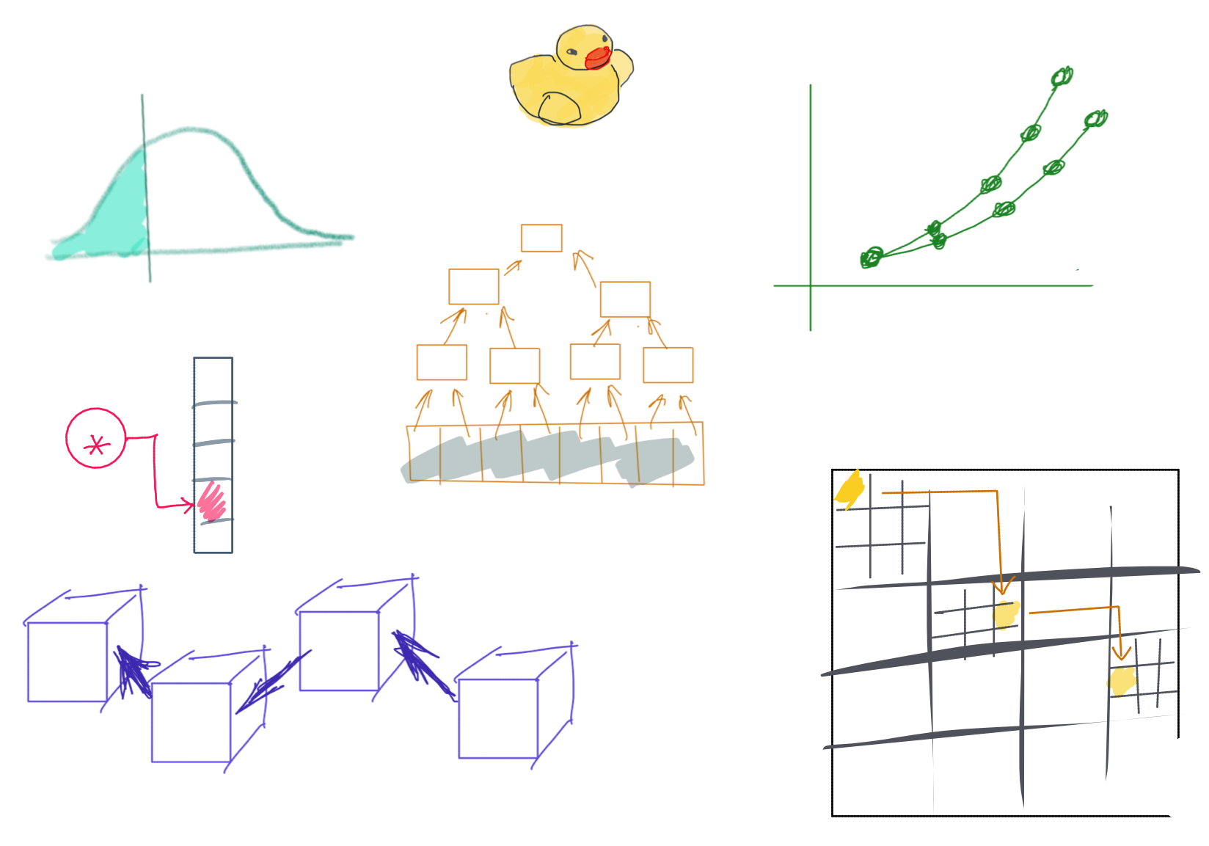

Slide 2
CSS342 Data Structures, Algorithms, and Discrete Mathematics (I)

Slide 3
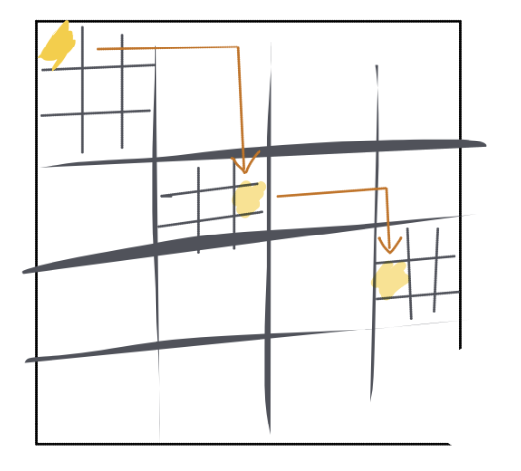
^{7th} Week Schedule
Midterm Review (Wed)
Expect grade by this Fri
Homework 3 review (Wed)
More on ADT hashtable (Wed)
Recursion (Wed & Friday)
Homework 4 is out

Slide 4
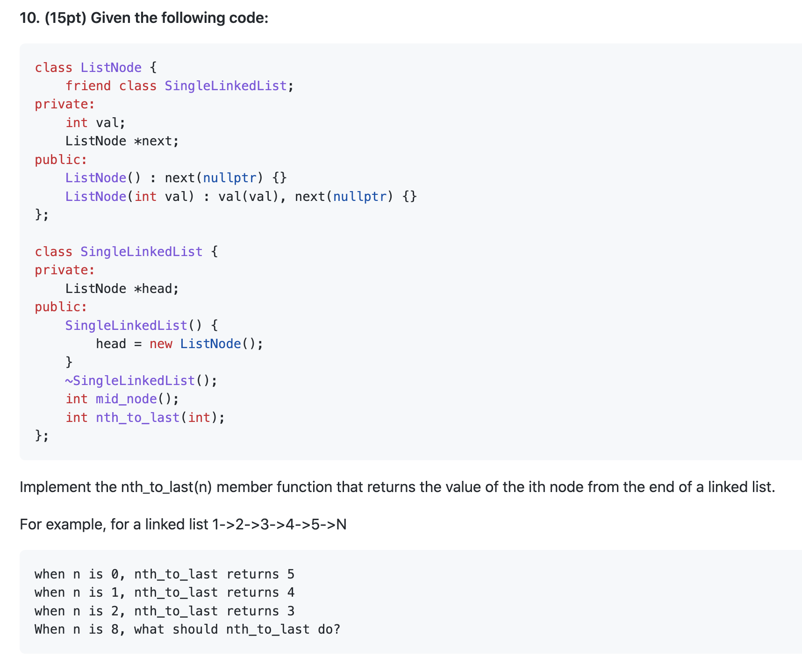
Midterm Review
The two-pointer trick
Exception

Slide 5
Midterm Review
h
1
2
3
4
n
p_slow
p_fast

Slide 6
Midterm Review
h
1
2
3
4
Two-pointer
Sliding window

Slide 7
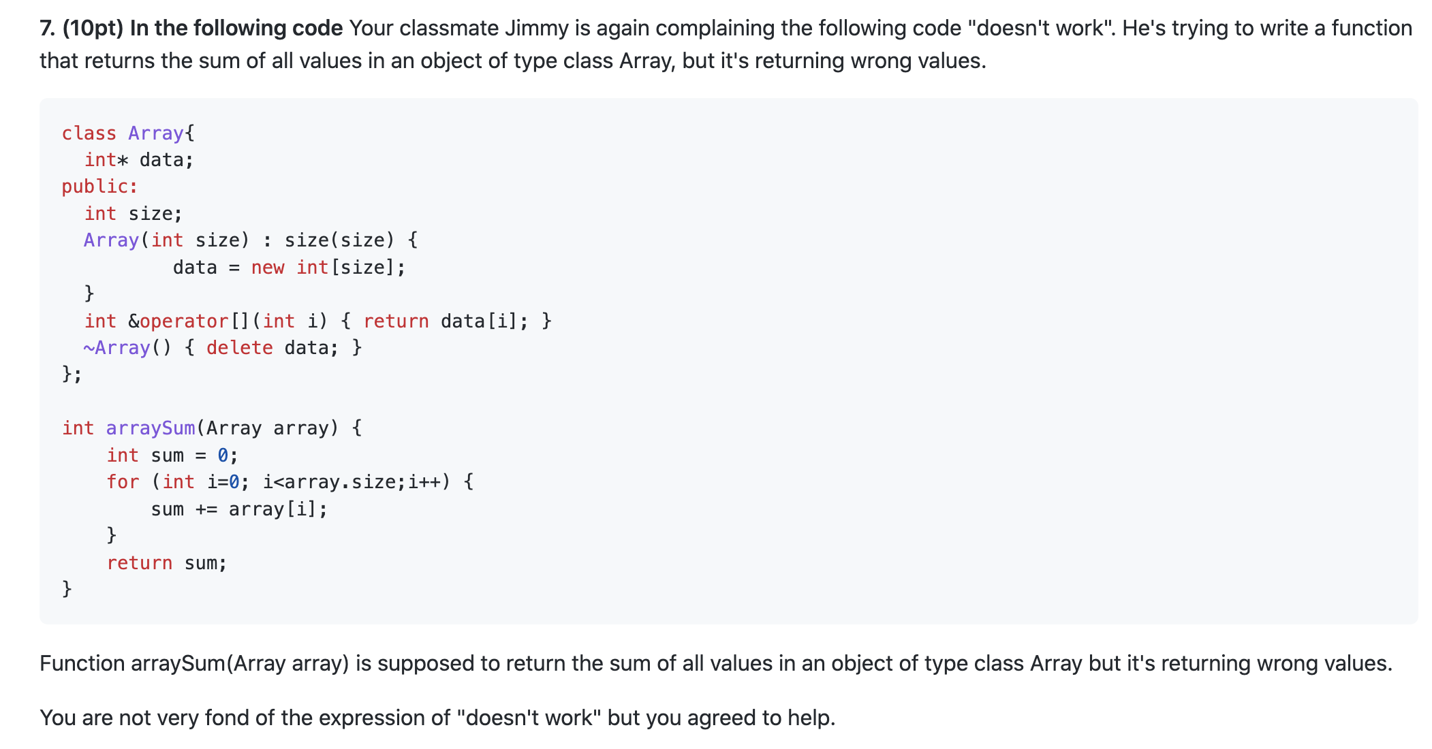
Midterm Review
Default copy constructor
Shallow copy

Slide 8
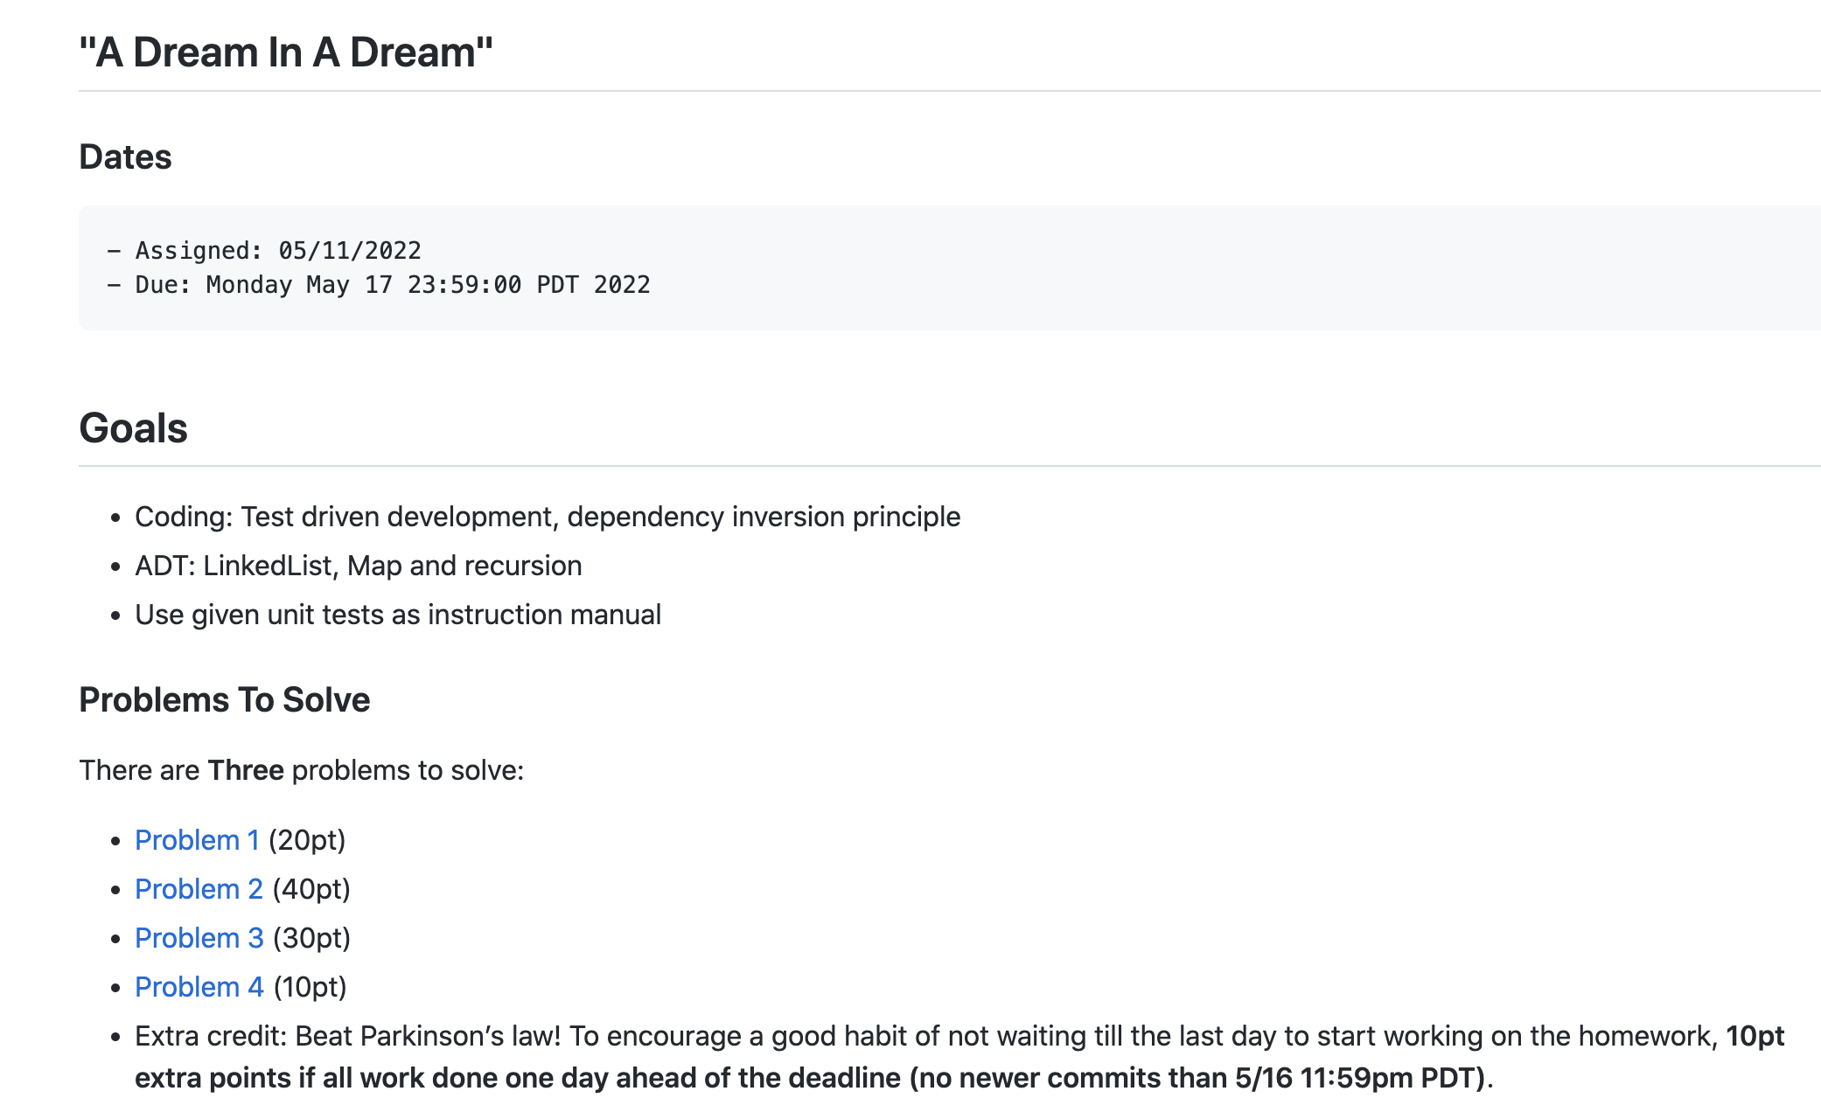
Homework 3 & 4

Slide 9
Where are we at now?
ADT (array vs list)
One-dimensional ADT
ArrayList
Stack
LinkedList
Queue
Hash table
Recursion
Search Problem
Sorting
Binary tree
multi-dimensional ADT

Slide 10
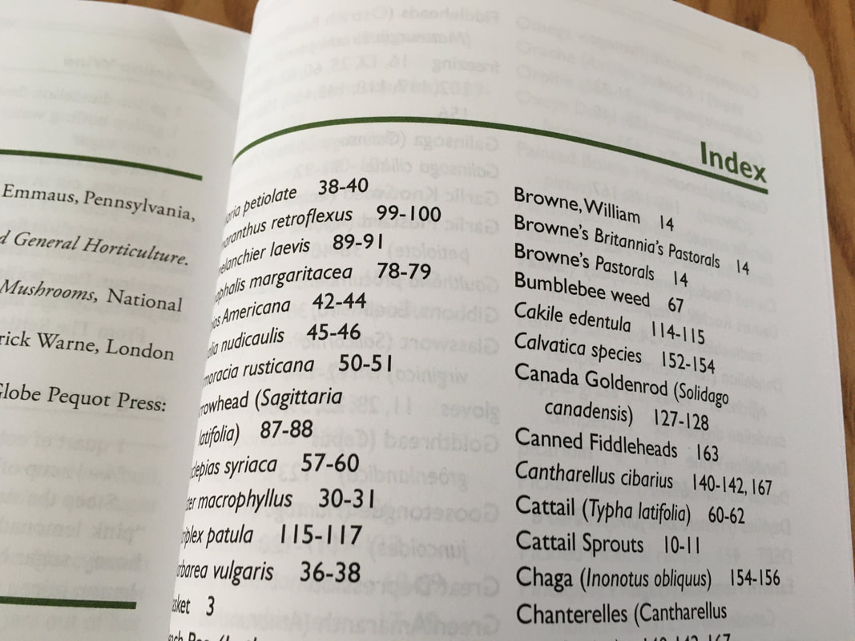
ADT HashTable
HashTable
Dictionary
Map
Set
O(1) “instant” search and insert/deletion

Slide 11
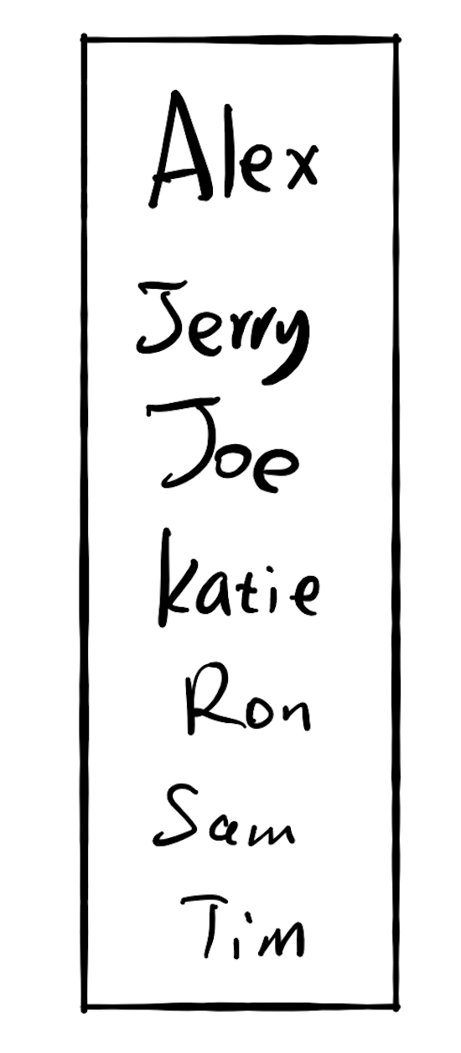
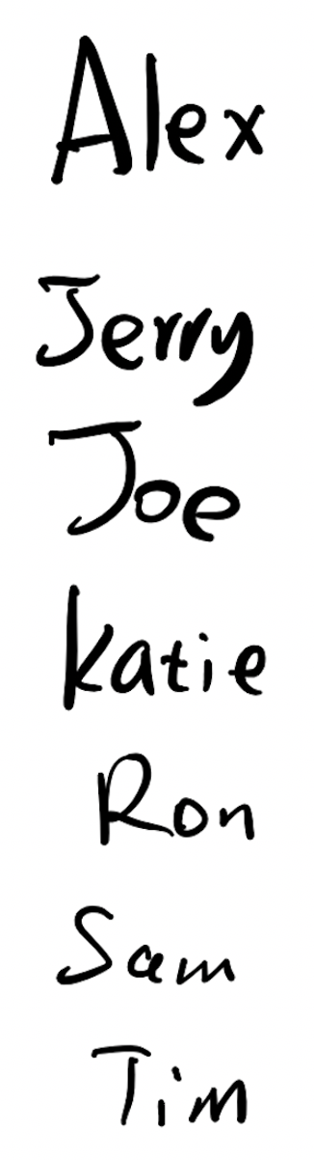
Fast for search
Slow for insertion
Slow for search
Fast for insertion

Slide 12
17.3 Do both fast?

Slide 13

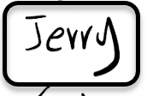
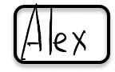
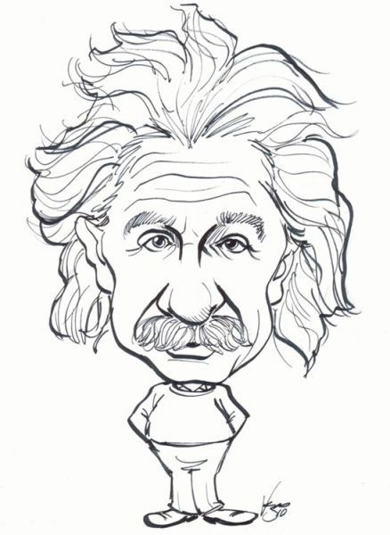





Slide 14
Hash Algorithm

Slide 15

0
3
hashing
6
7
9
12
13
hashing
8

Slide 16
Key value pair: (K, V)
(K,V)
Hash function
6
Hash key
key K

Slide 17
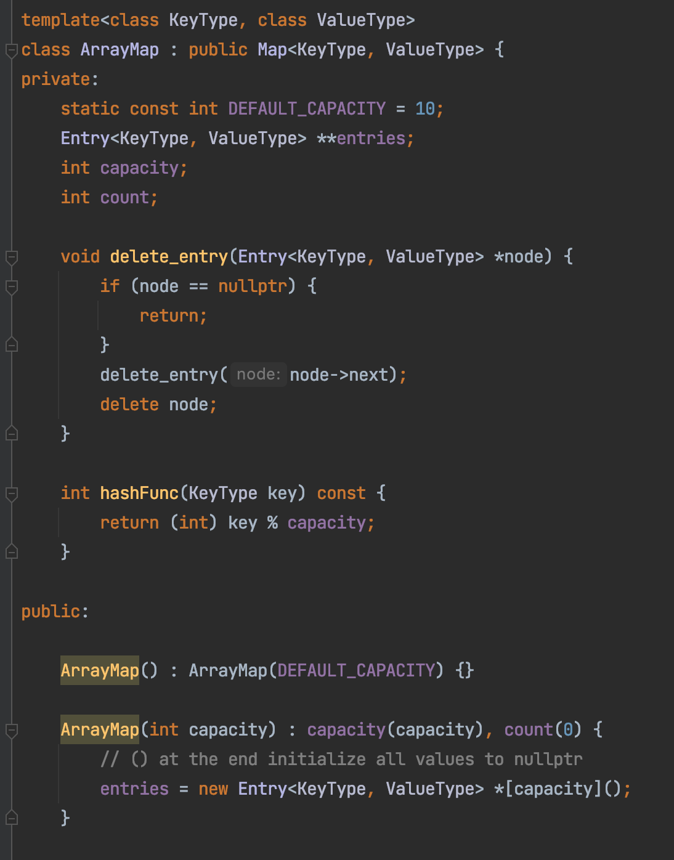
ArrayMap

Slide 18
Hashing
Key x
Index y
“Key”
“Hash Key”
String
Integer

Slide 19
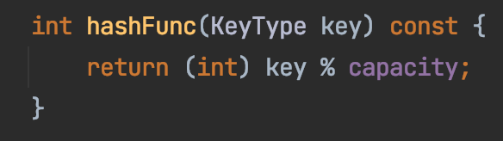
Hashing
Key x
Index y
String
Integer

Slide 20
Collision
collision
key=Sam
key=Ron

Slide 21
Collision
Three approaches
Better hashing algorithm
Find another location in the table
3. Modify the entry to be able to hold more than one set of values
https://medium.com/basecs/hashing-out-hash-functions-ea5dd8beb4dd
“open addressing”

Slide 22
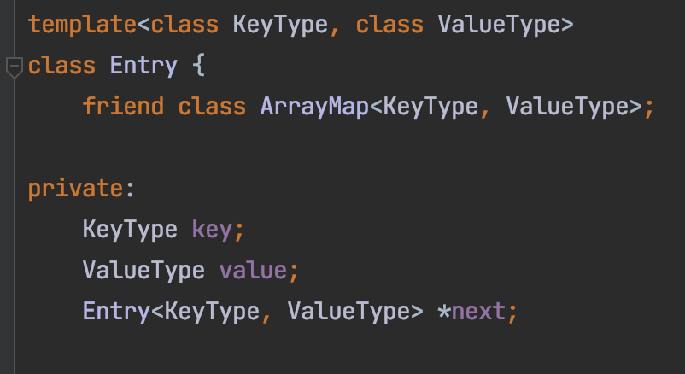
Chaining
Sam
Ron
key=Sam
key=Ron

Slide 23
Chaining
Sam
Ron
Alex
Jerry
Katie
Joe
Tim

Slide 24
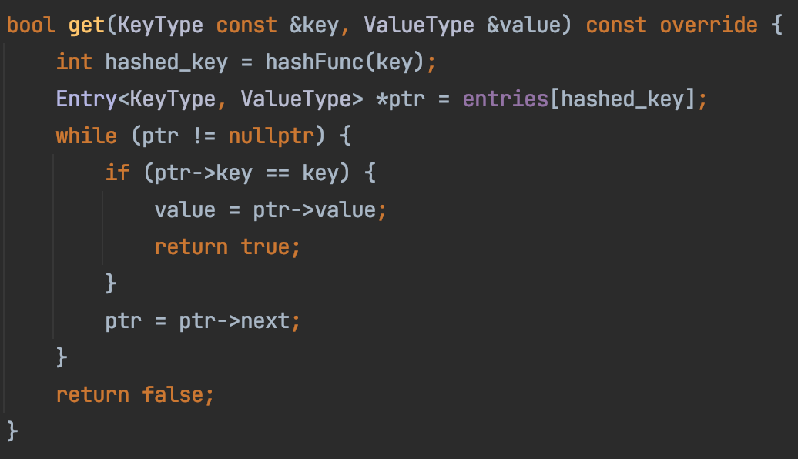
ArrayMap

Slide 25
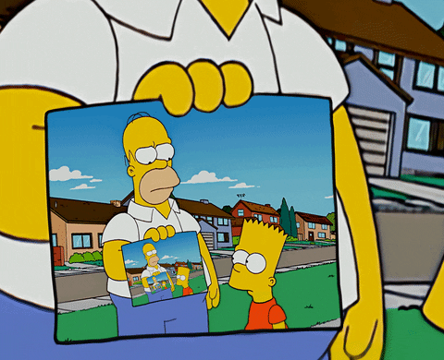
Recursion
A function that calls itself
void callMeMaybe() {
printf(“Hello Maybe!”);
callMeMaybe();
}
Not specific to Java

Slide 26
Why Recursion?
Problem using as complex data structure
Problems of recurring nature

Slide 27

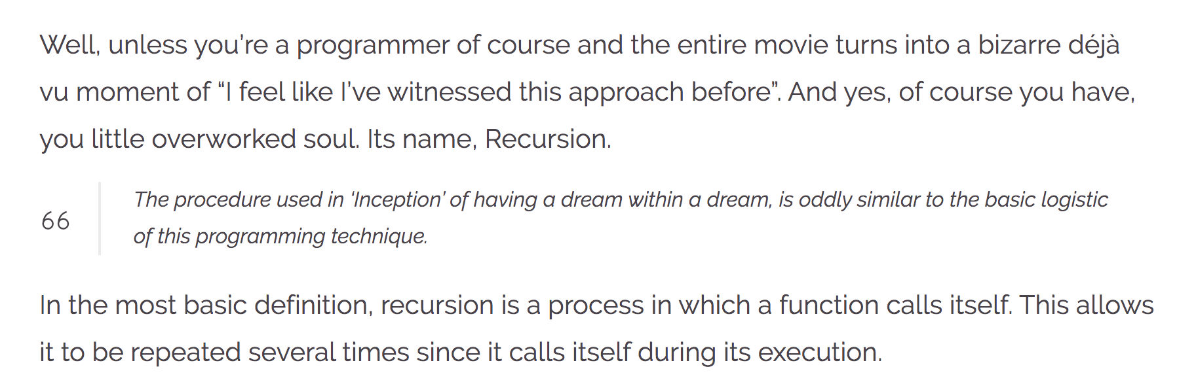
Recursion
https://wewrite.taleas.io/2018/11/14/why-inception-reminds-us-of-recursion/

Slide 28
Recursion

Slide 29
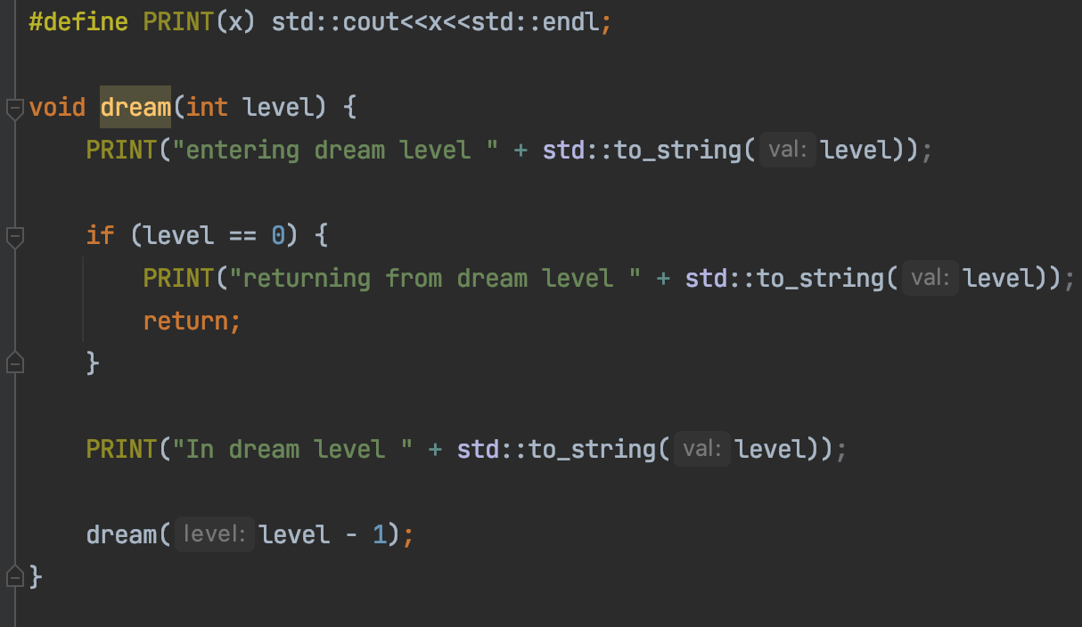
Dream in Recursion

Slide 30
Dream in Dream
Level 2
Level 1
Level 0
Time

Slide 31
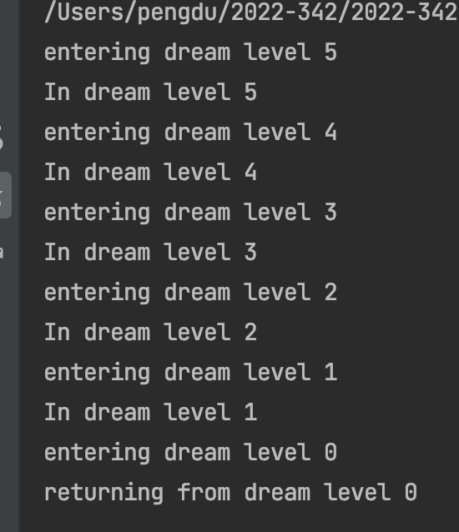
Dream in Recursion

Slide 32
Dream in Recursion
Exit condition

Slide 33
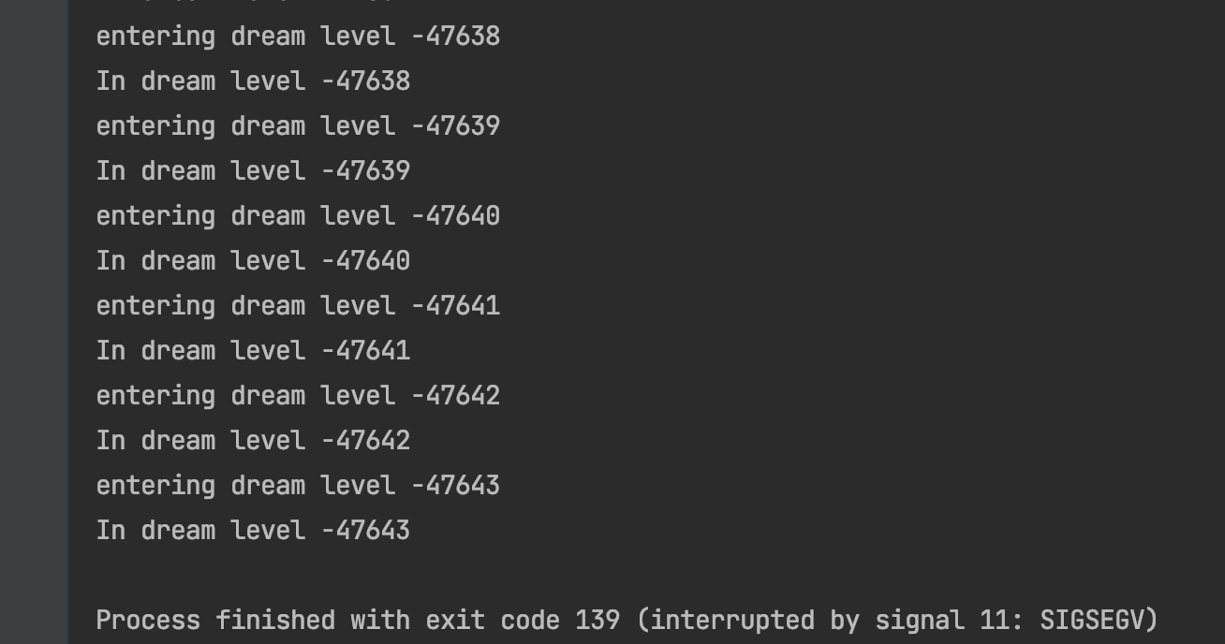
Dream in Recursion
Missing exit condition

Slide 34
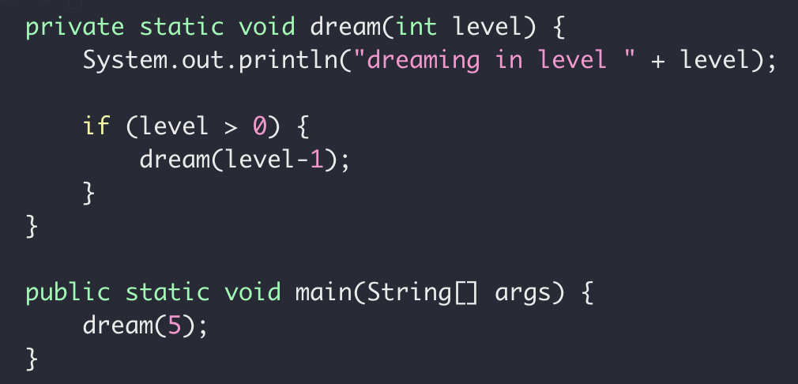
Recursion
Exit Condition
When the subproblem is ”small enough”
Stop recursion
solved directly

Slide 35
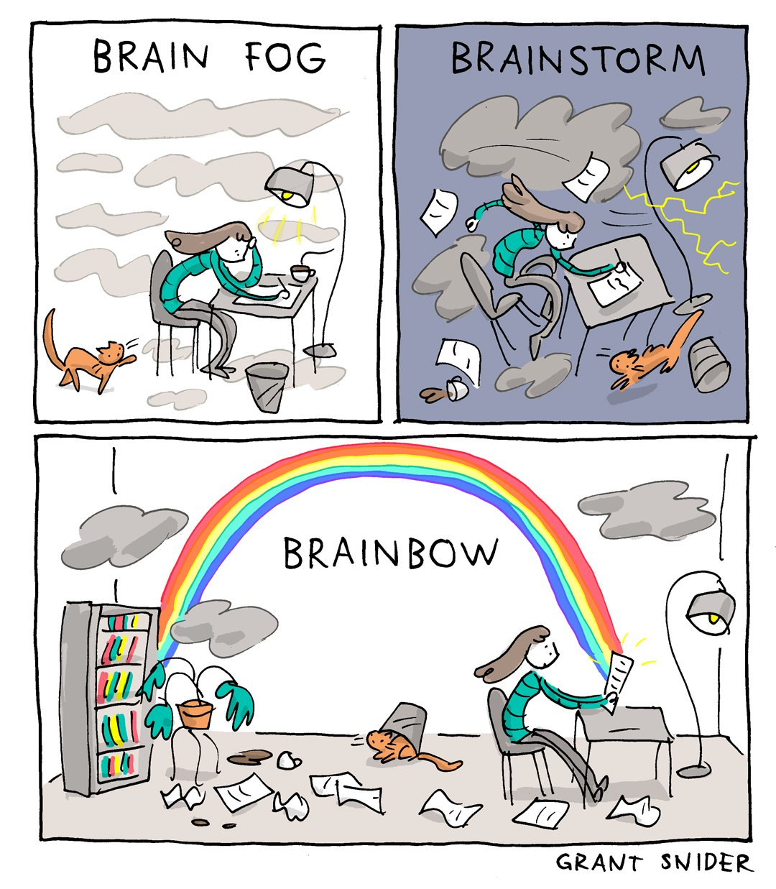
Typical (Home)Work Process
Mid-semester 1:1

Slide 36
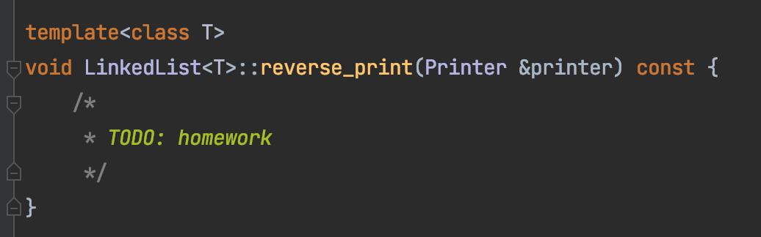
Homework 4 – Task 1
h
1
2
3
4
n
Create a stack
Traverse the list front to end, push each element onto a stack
Loop till the stack is empty,
Pop out every element from the stop
print the element

Slide 37
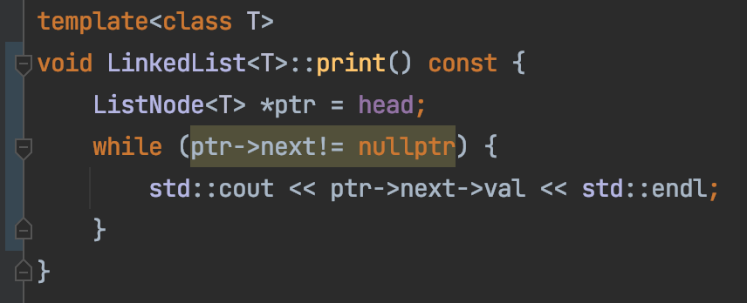
Dependency (is bad)
Dependency on std::cout
We can’t control the output

Slide 38
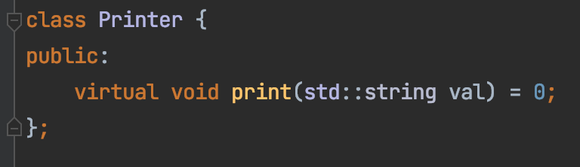
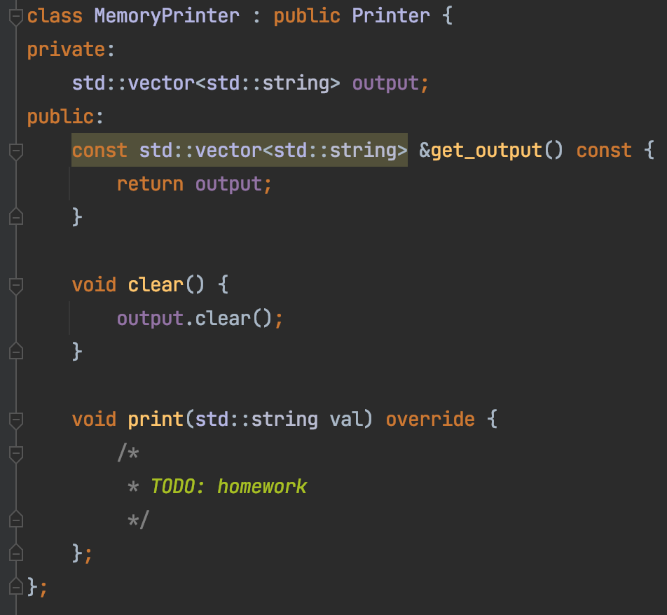

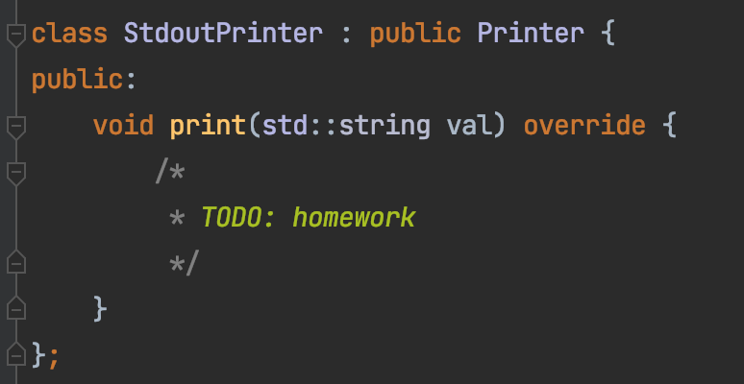
Homework 4 – Task 1
Decouple our code from how print is done
Interface
Implementation – For real use
Implementation – For testing

Slide 39
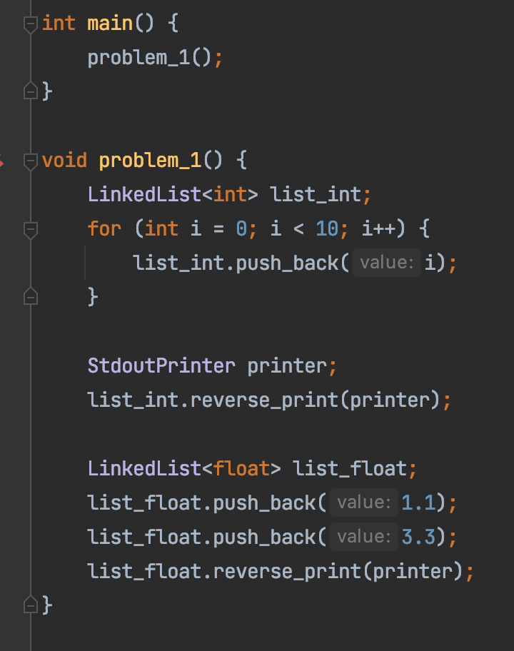
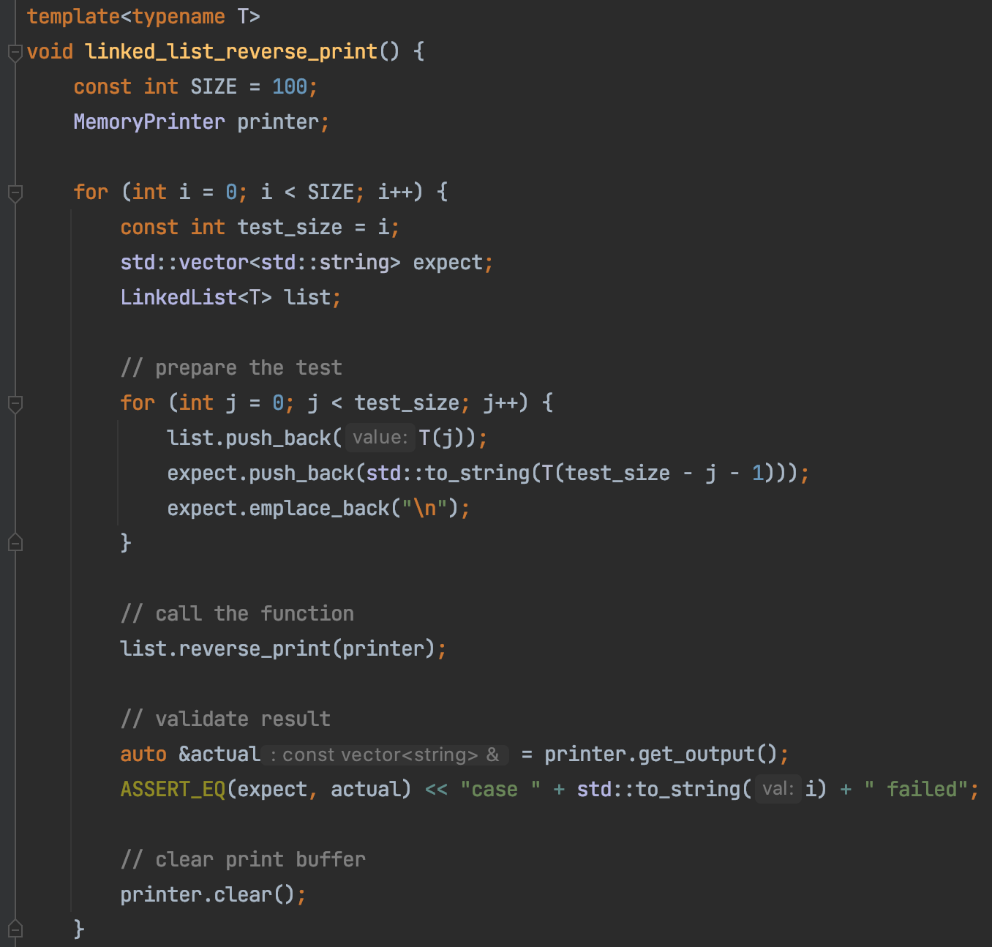
Homework 4 – Task 1
Real use
Unit testing

Slide 40
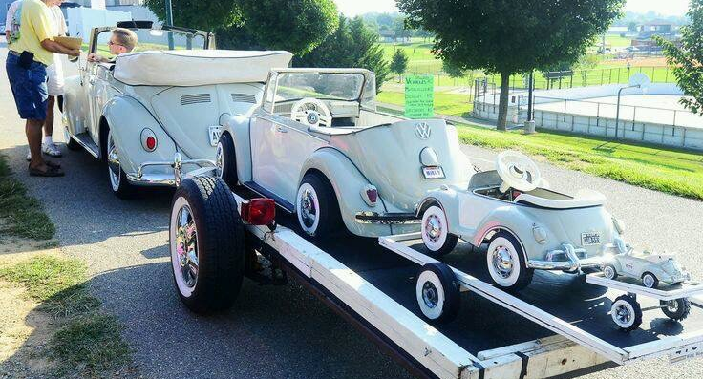
Recursion, cont.

Slide 41
Recursion
How it works
When to use it
When NOT to use it

Slide 42
”guess them all”
?
?
?
A gift in one of the box

Slide 43
?
?
?
Recursion: Search solution in every possible path

Slide 44
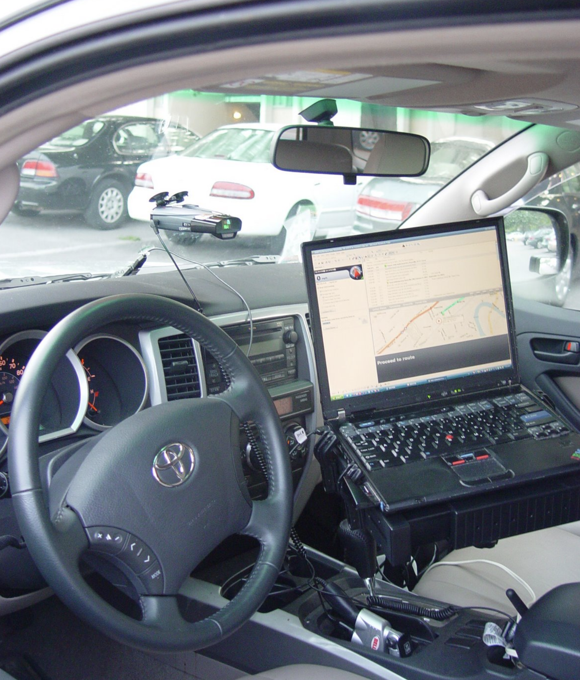
Backtracking
Kayaking trip
Fontana Lake, 07/03/2007

Slide 45
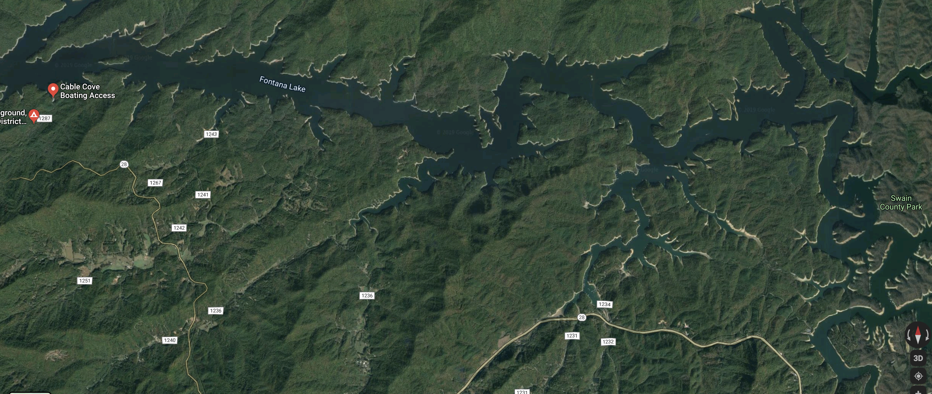
Backtracking

Slide 46
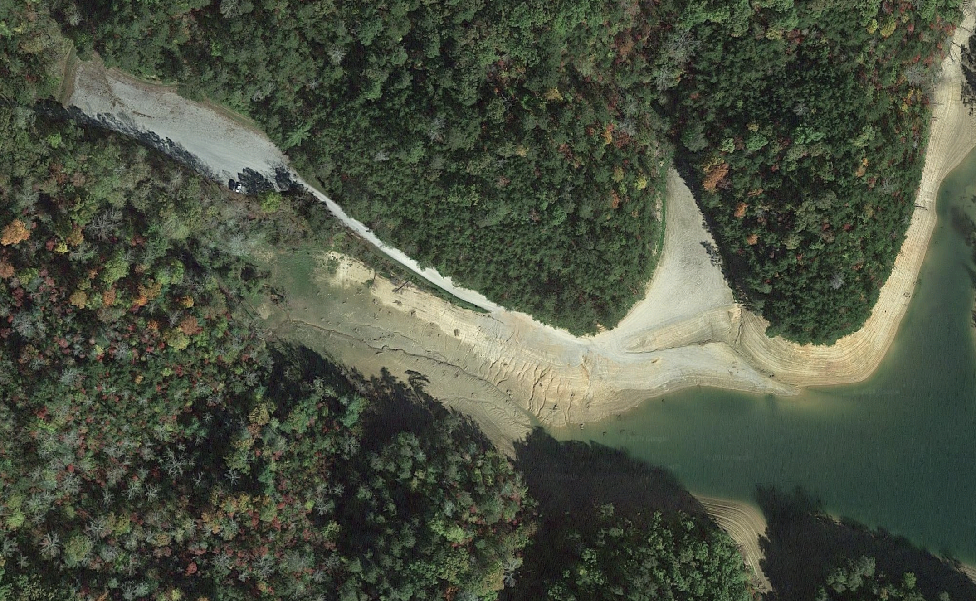
Backtracking

Slide 47

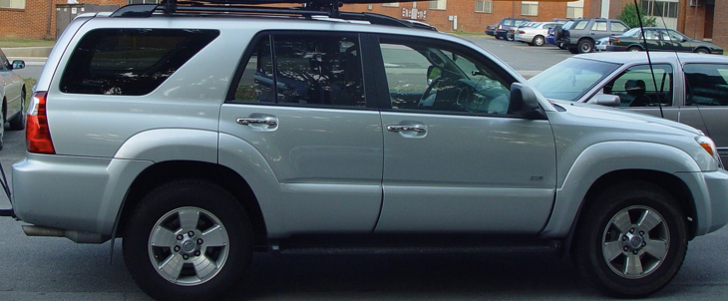
Backtracking

Slide 48
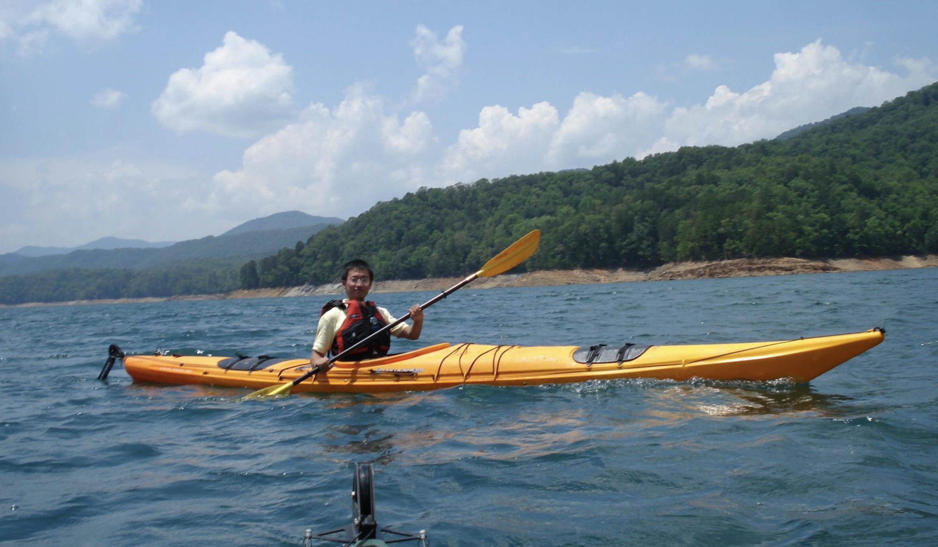

Backtracking

Slide 49
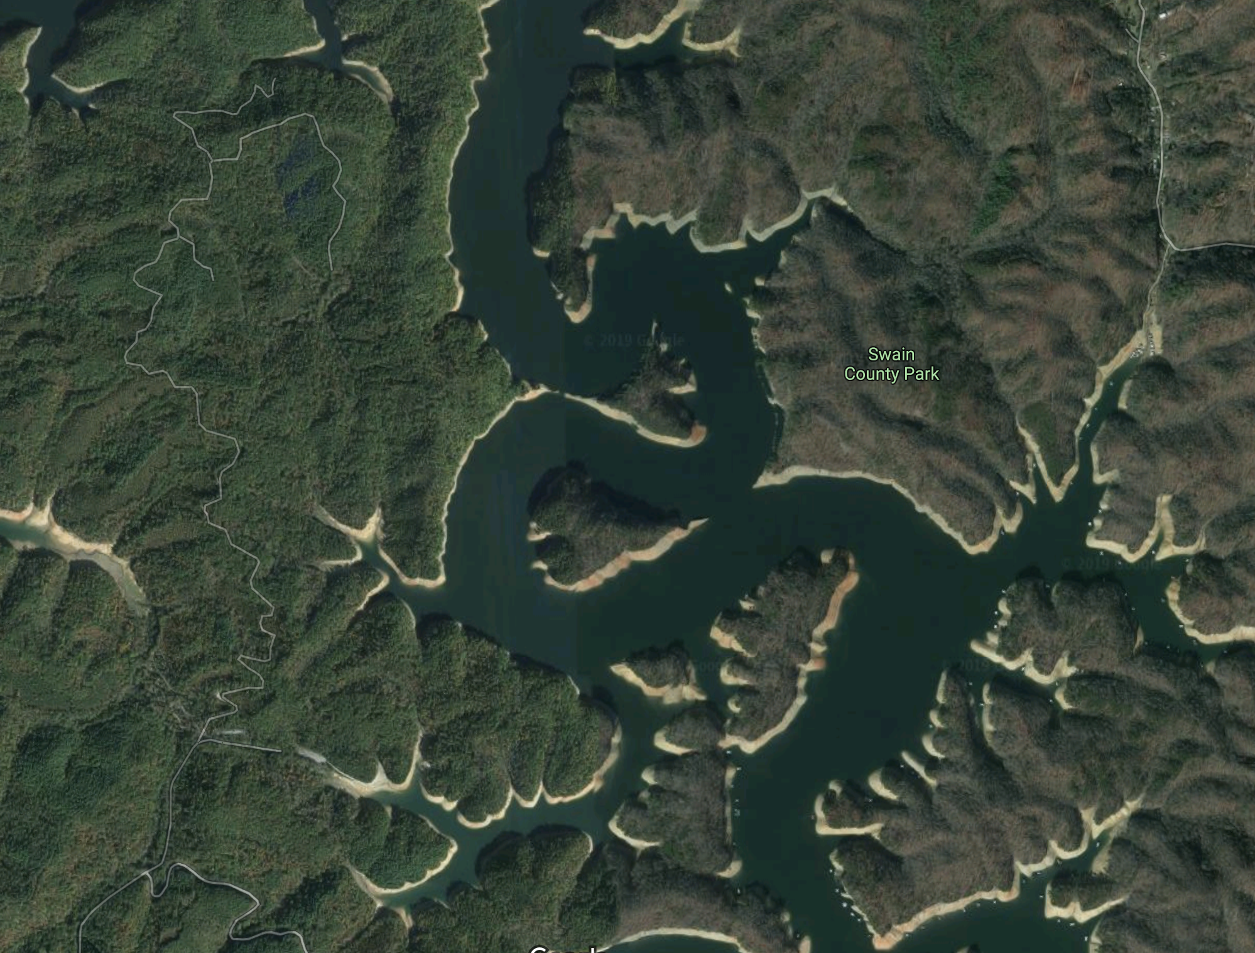
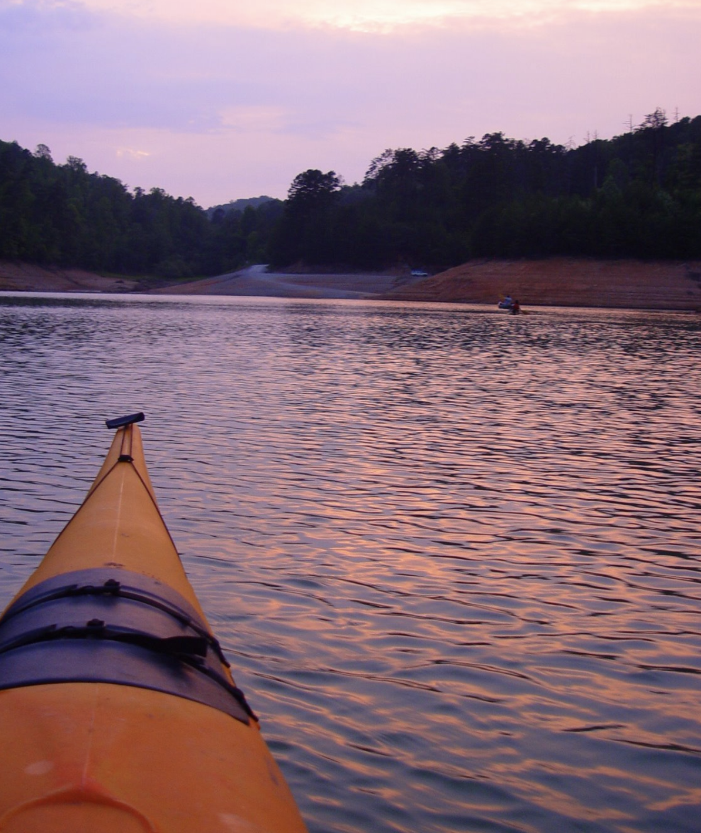
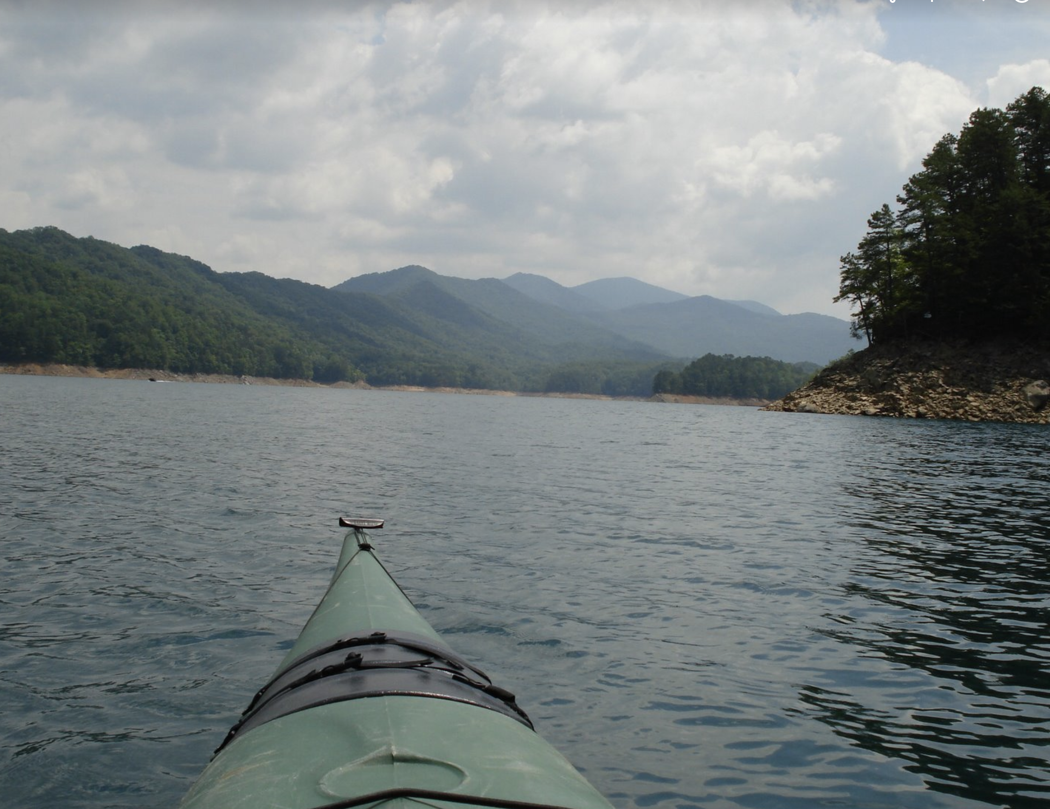

Backtracking

Slide 50
Backtracking
Move forward if there’s only one possible path
When there’s a fork, go with one of paths
If it too far, return (backtrack) to the fork, and try the other paths

Slide 51
Backtracking

Slide 52
Backtracking
TOO FAR!

Slide 53
Backtracking
NOP!

Slide 54
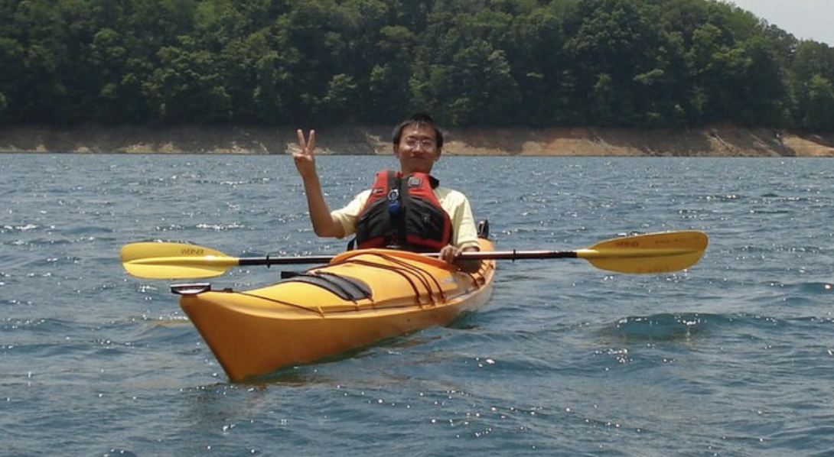
Backtracking

Slide 55

Backtracking trip
When in doubt, keep calm and backtrack!

Slide 56
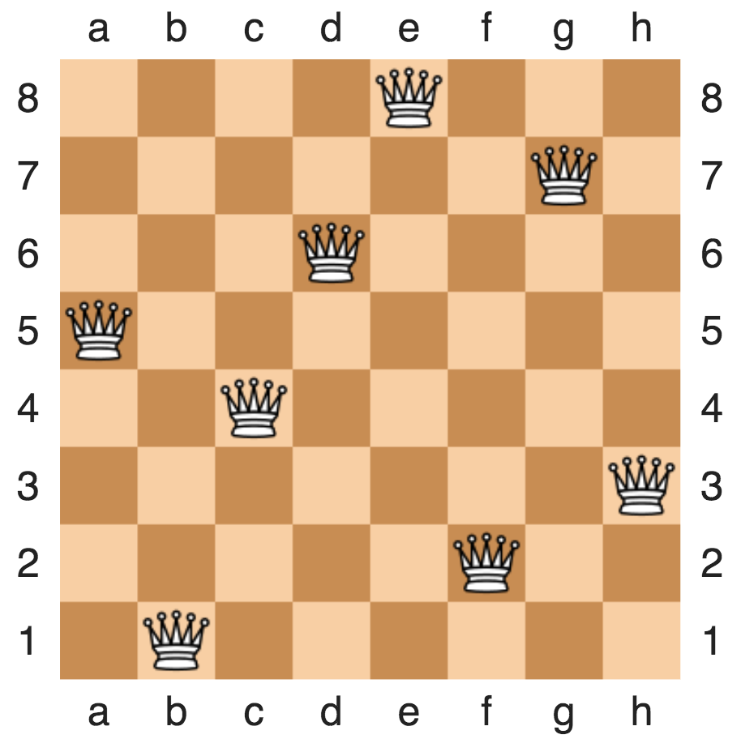
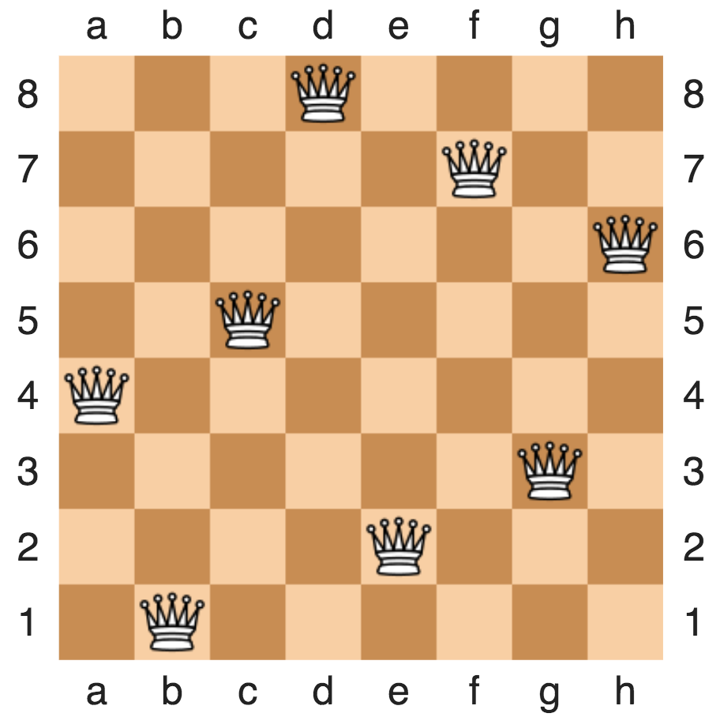
Backtracking example: 8-queue problem
Placing eight queens on an 8×8 chessboard
None of them attack one another
no two are in the same row, column, or diagonal
https://en.wikipedia.org/wiki/Eight_queens_puzzle

Slide 57
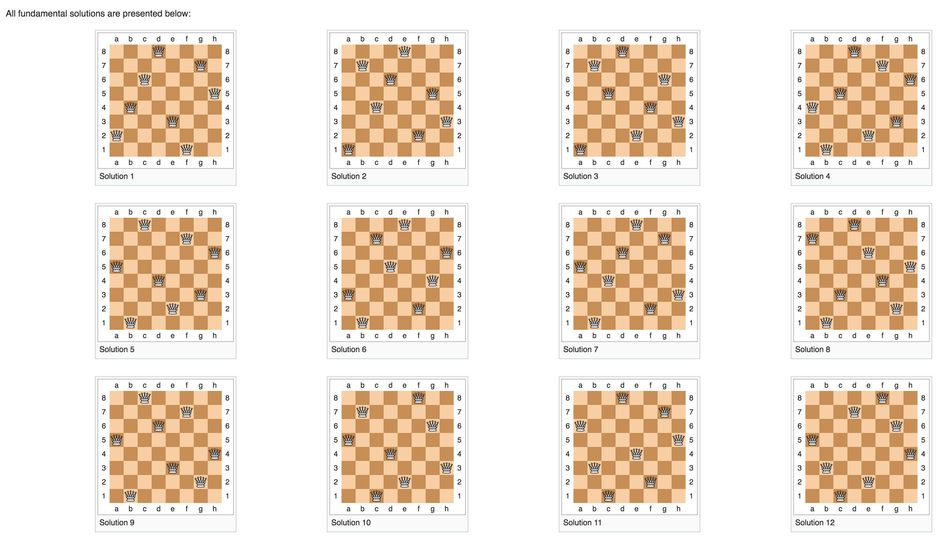
Backtracking example: 8-queue problem
Placing eight queens on an 8×8 chessboard
None of them attack one another
no two are in the same row, column, or diagonal
https://en.wikipedia.org/wiki/Eight_queens_puzzle

Slide 58
Backtracking example: N-queue problem
Placing eight queens on an N×N chessboard
None of them attack one another
no two are in the same row, column, or diagonal

Slide 59
Annimation at http://www.brainmetrix.com/8-queens/

Slide 60
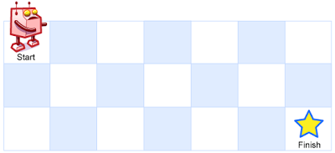

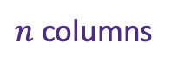
Recursion In Class Exercise: Unique Paths
A robot is located at the top-left corner of a grid
The robot can only move either down or right at any point in time.
How many possible unique paths are there?
$m$ rows
$n$ columns

Slide 61
Recursion In Class Exercise: Unique Paths
A robot is located at the top-left corner of a grid
The robot can only move either down or right at any point in time.
$m$ rows
$n$ columns

Slide 62
Recursion In Class Exercise: Unique Paths
Finish it here on LeetCode
A robot is located at the top-left corner of a grid
The robot can only move either down or right at any point in time.
$m$ rows
$n$ columns

Slide 63
Unique Paths
1
1
1
1
2
1

Slide 64
Unique Paths
1
1
1
1
1
1
2
3
4
5
1
3
6
10
15

Slide 65
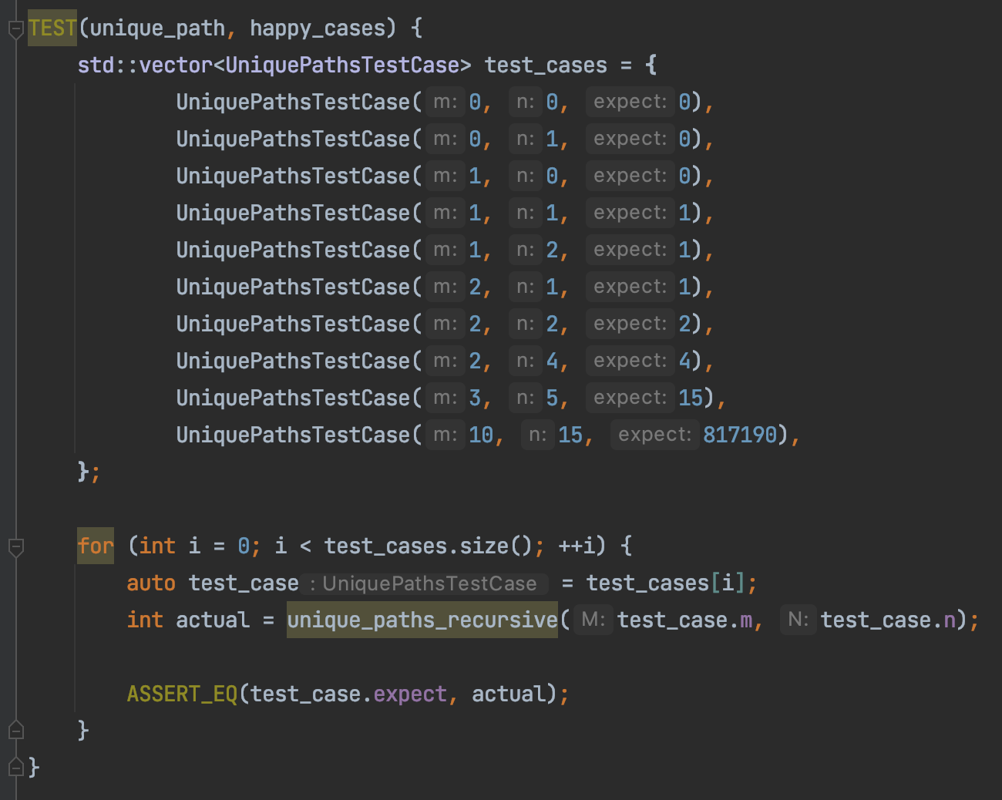
Unique Paths Tests

Slide 66
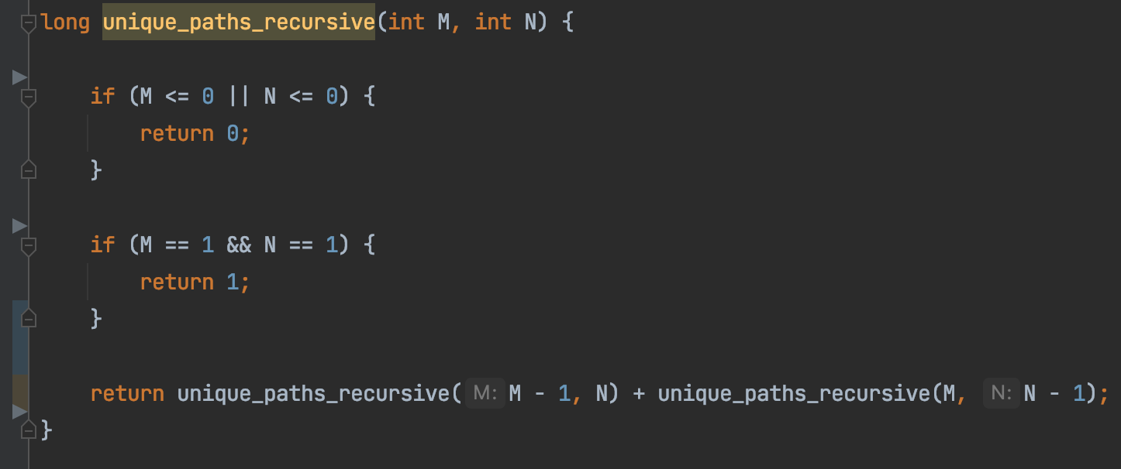
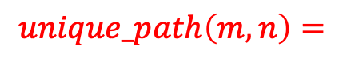
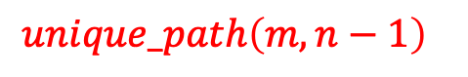
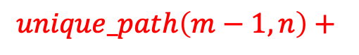


Unique Paths
1
1
1
1
1
$m$ rows
1
2
3
4
3
4
$$unique_path\left(m, n\right)=$$
$n$ columns
$$unique_path\left(m−1, n\right)+$$
$$unique_path\left(m, n−1\right)$$

Slide 67

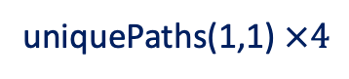

Unique Paths Tests
unique_paths(3,4)
1
2
3
4
3,4
2,4
1,4
1,3
1,2
1,1
1
2,3
1,3
1,2
1,1
2
$m$ rows
2,2
1,2
1,1
2,1
1,1
3
$n$ columns
uniquePaths(1,1) $×4$

Slide 68


Unique Paths Tests
unique_paths(3,4)

Slide 69

Unique Paths Tests
unique_paths(5,8)

Slide 70

Unique Paths Tests
unique_paths(10,15)
Repeated subproblem

Slide 71

Unique Paths Tests
unique_paths(20,30)
Dude it’s been 30 minutes…

Slide 72
Unique Paths
Repeated subproblems
1
1
1
1
1
1
2
3
4
5
recursion
1
3
6
10
15

Slide 73
Unique Paths
Iterative solution
1
1
1
1
1
1
2
3
4
5
1
3
6
10
15
Dynamic programming FTW
How much memory storage space do you need?

Slide 74
Recursive Binary Search
Target: 14
1
3
5
7
9
10
12
12
14
14
18

Slide 75
Recursive Binary Search
binary_search(data, target)
Target: 14
binary_search(data, target, start = 0, end = size-1)
1
3
5
7
9
10
12
12
14
18

Slide 76
Recursive Binary Search
binary_search(data, target)
Target: 14
binary_search(data, target, start = 5, end = 9)
1
3
5
7
9
10
12
12
14
18

Slide 77
Recursive Binary Search
binary_search(data, target)
Target: 14
binary_search(data, target, start = 8, end = 9)
1
3
5
7
9
10
12
12
14
18

Slide 78

Recursive Binary Search
binary_search(data, target)
Target: 14
binary_search(data, target, start = 8, end = 8)
1
3
5
7
9
10
12
12
14
18

Slide 79

Function Call Stack

Slide 80
“Nothing is free”
Every function call consumes memory
Even if that function is empty

Slide 81


“Endless Dream”

Slide 82

Function Call Stack
Heap
Int[10]
Stack
local_primitive
local_reference
Memory

Slide 83

Stack For Function Call
stack for foo
stack for main

Slide 84

stack for foo
stack for main
A good post

Slide 85
Stack For Function Call
stack for dream
stack for dream
stack for dream
stack for dream
stack for dream
stack for dream
stack for dream
stack for dream
stack for dream
stack for main

Slide 86


Buffer Overflow Attack
Local variable for good_code
stack for good_code
Write overflow
Return instruction address
stack for main
Stack smashing

Slide 87
Summary
Recursion
Function call consumes resources
How much do we have?
Repeated sub-problems → “sloooow”
A reference

